Slide 1
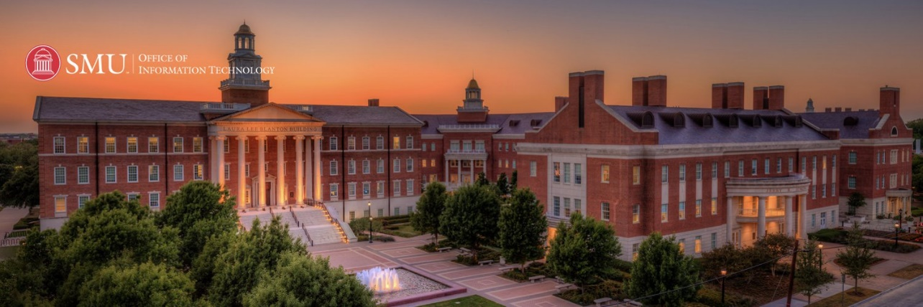
WORKSHOP
INTRODUCTION TO DEEP LEARNING
Tue Vu, PhD
Research & Data Science Services
SMU OIT
Notes:
Idea follow Vblog: machinelearningcoban and Deep Learning 101
Machine Learning cơ bản (machinelearningcoban.com)
Deep Learning 101 - Part 1: History and Background (beamandrew.github.io)

Slide 2
Outline
Convolution Neural Network
Recurrent Neural Network
Long-Short Term Memory

Slide 3
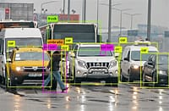
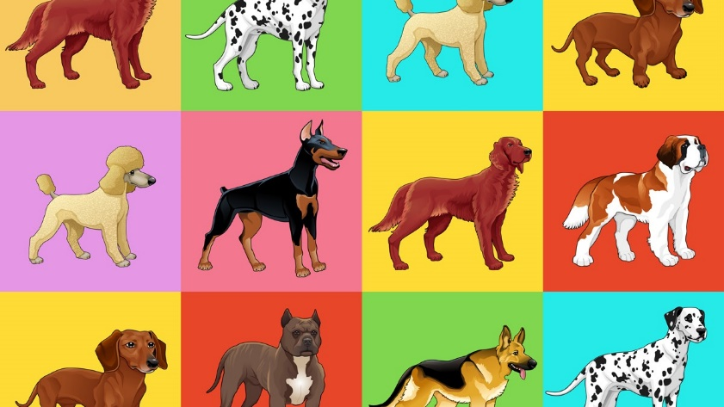
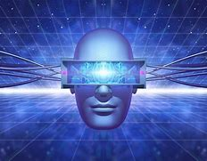
1. Convolution Neural Network
CNNs are one type of ANN which utilize the neuron, kernel, activation function.
Inputs must be in images (or assumed to be images in 2D format)
Using Forward & Backpropagation technique with certain property to process it faster
CNNs best for object detection, image classification, computer vision

Slide 4
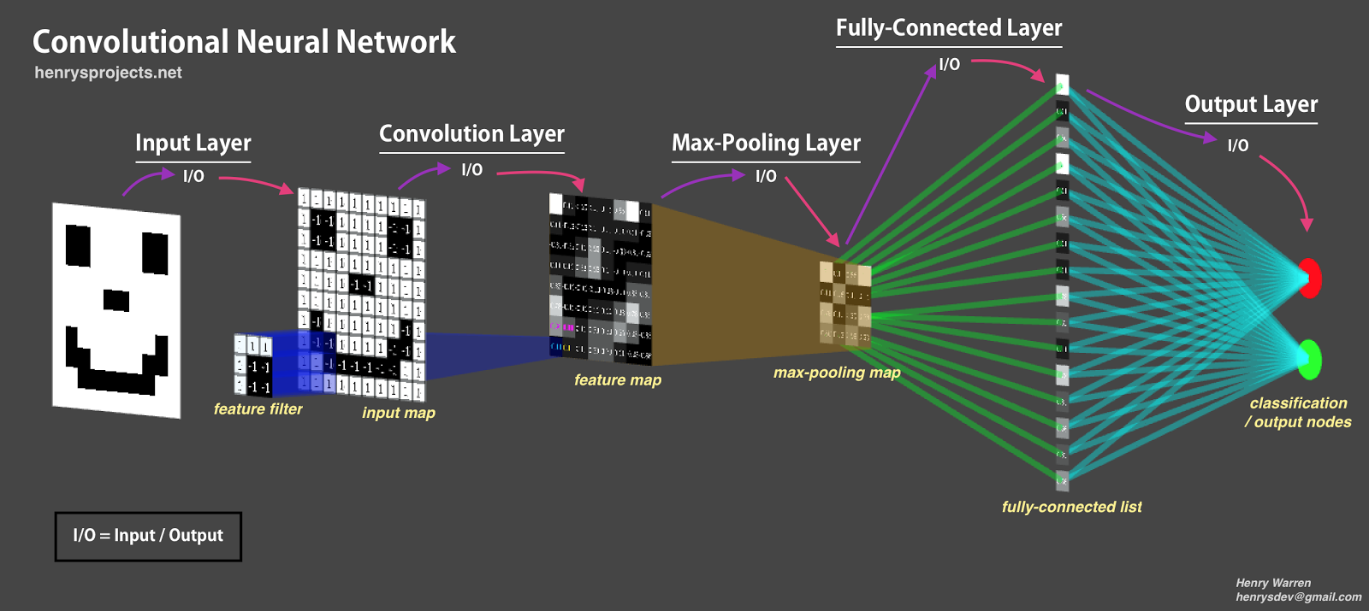
1. Convolution Neural Network
Architecture of MLPs
Fully connected (Dense) Layer
Previous examples (MNIST, Fashion MNIST) use fully connected MLP NN to predict the images
The accuracy/loss are ok but not so great

Slide 5
1. Convolution Neural Network
Architecture of CNNs
Feature Extraction

Slide 6
1. Convolution Neural Network
Architecture of CNNs
Convolutional Layers
Pooling Layers
Flatten Layer

Slide 7
1. Convolution Neural Network
Parameters of Convolutional Layers (Conv2D):
Depth
Filter/kernel
Stride
Padding

Slide 8
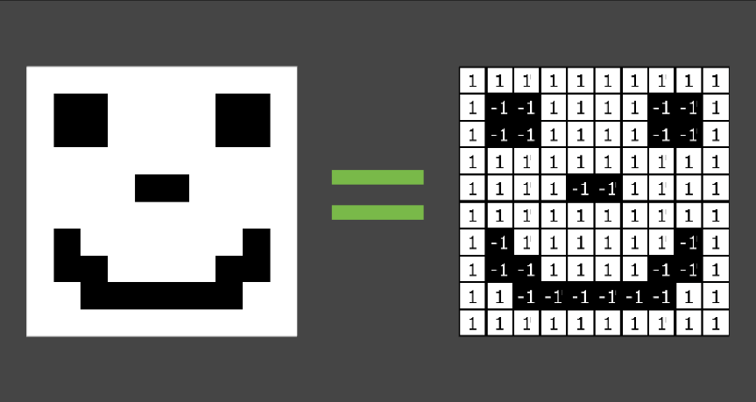
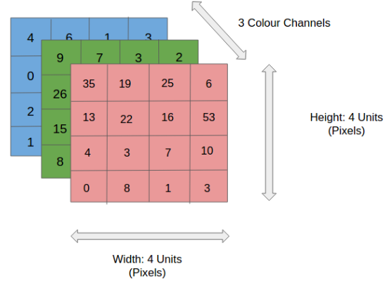
1. Convolution Neural Network
Parameters of Conv2D: depth
MNIST
Fashion MNIST
Depth = 1
Regular images
Depth = 3
(RGB)
Notes:
Take a look at the simple gray scale image below which contains 10 pixels on width & height. The color scale has only 2 values (black & white) or (binary -1 and 1), there fore the size of the following image is 10x10x1:

Slide 9
1. Convolution Neural Network
Parameters of Conv2D: filter & kernel
Notes:
Take a look at the simple gray scale image below which contains 10 pixels on width & height. The color scale has only 2 values (black & white) or (binary -1 and 1), there fore the size of the following image is 10x10x1:

Slide 10
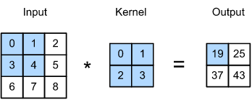
1. Convolution Neural Network
Parameters of Conv2D: filter & kernel
- dot product
(10,10,1)
Notes:
A regular image contains colors RGB with each color scale from 0-255

Slide 11
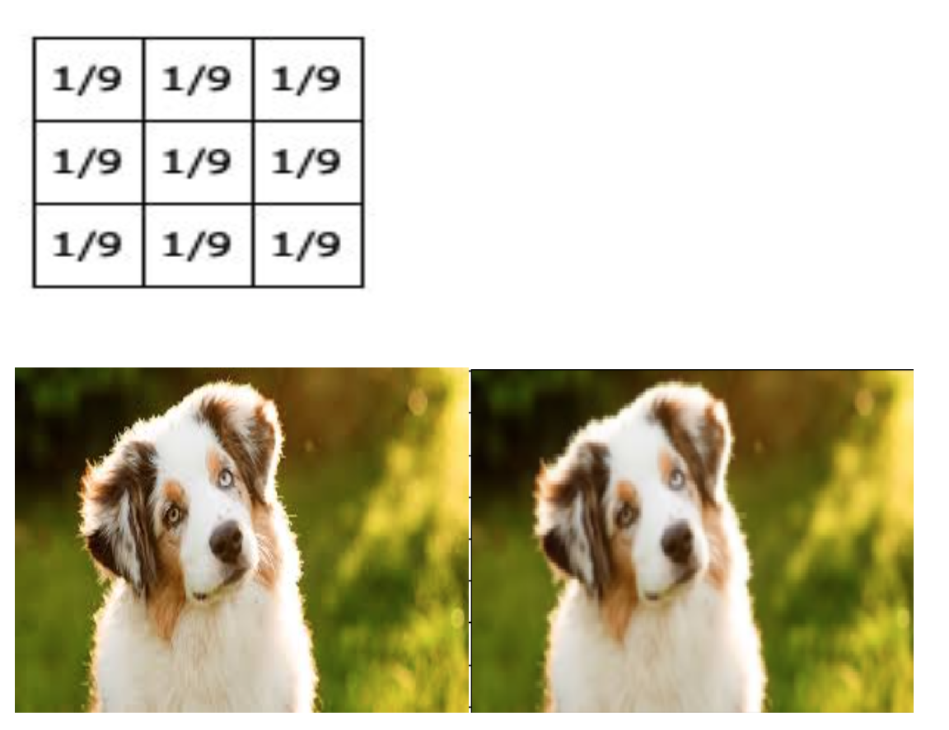
1. Convolution Neural Network
Parameters of Conv2D : filter & kernel
Kernel size (3,3)
(10,10,1)
Blur filter
Notes:
Multiplied with 3 color channel RGB

Slide 12
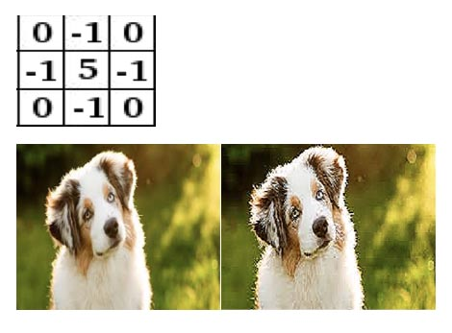
1. Convolution Neural Network
Parameters of Conv2D : filter & kernel
Kernel size (3,3)
(10,10,1)
Sharp filter
Notes:
Multiplied with 3 color channel RGB

Slide 13
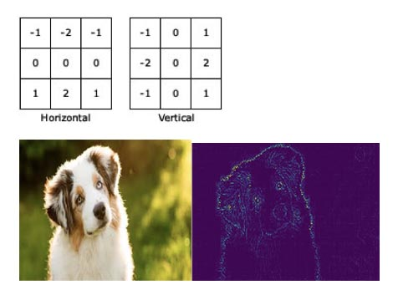
1. Convolution Neural Network
Parameters of Conv2D : filter & kernel
Kernel size (3,3)
Edge detection

Slide 14
1. Convolution Neural Network
Parameters of Conv2D : filter & kernel
Convolved Feature with filter
(10,10,1)
CNN uses the Convolved Feature to reduce the image size by dot product with given kernel (filter)
The image reduction without losing features and easier to process for good prediction
In CNNs, filters are not defined. The value of each filter is learned during the training process.
Notes:
Introduction of kernel

Slide 15
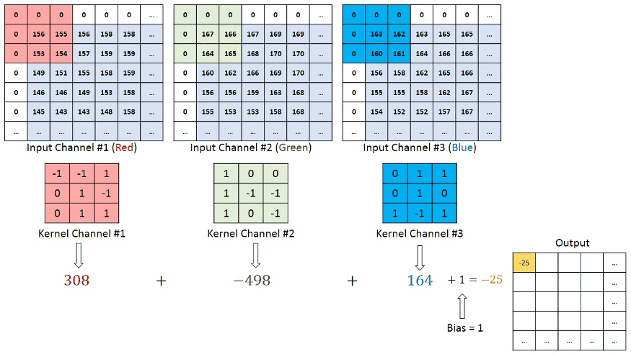
1. Convolution Neural Network
Parameters of Conv2D : filter & kernel
(10,10,1)
Kernel size (3,3)
3 kernels = 3 filters
Notes:
Multiplied with 3 color channel RGB

Slide 16
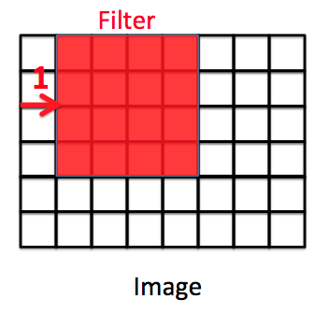
1. Convolution Neural Network
Parameters of Conv2D : stride
Stride tuned for the compression of images and video data
Stride = (1,1)
Notes:
Take a look at the simple gray scale image below which contains 10 pixels on width & height. The color scale has only 2 values (black & white) or (binary -1 and 1), there fore the size of the following image is 10x10x1:

Slide 17
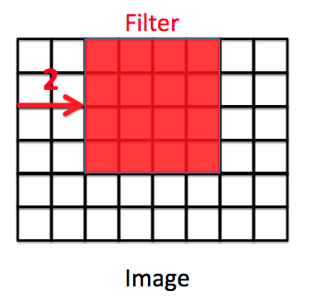
1. Convolution Neural Network
Parameters of Conv2D : stride
Stride tuned for the compression of images and video data
Stride = (1,1)
Stride = (2,2)
Notes:
Take a look at the simple gray scale image below which contains 10 pixels on width & height. The color scale has only 2 values (black & white) or (binary -1 and 1), there fore the size of the following image is 10x10x1:

Slide 18
1. Convolution Neural Network
Parameters of Conv2D : stride
Stride tuned for the compression of images and video data
Stride = (1,1)
Stride = (2,2)
Stride = (2,1) or (1,2)?
Yes but not common
Notes:
Take a look at the simple gray scale image below which contains 10 pixels on width & height. The color scale has only 2 values (black & white) or (binary -1 and 1), there fore the size of the following image is 10x10x1:

Slide 19
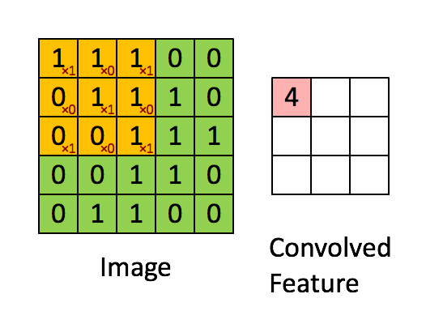
1. Convolution Neural Network
Parameters of Conv2D : padding
- The pixels located on the corners and the edges are used much less than those in the middle => the information on borders and edges are note preserved
Notes:
Take a look at the simple gray scale image below which contains 10 pixels on width & height. The color scale has only 2 values (black & white) or (binary -1 and 1), there fore the size of the following image is 10x10x1:

Slide 20
1. Convolution Neural Network
Parameters of Conv2D : padding
- The pixels located on the corners and the edges are used much less than those in the middle => the information on borders and edges are note preserved
Solution?
Notes:
Take a look at the simple gray scale image below which contains 10 pixels on width & height. The color scale has only 2 values (black & white) or (binary -1 and 1), there fore the size of the following image is 10x10x1:

Slide 21
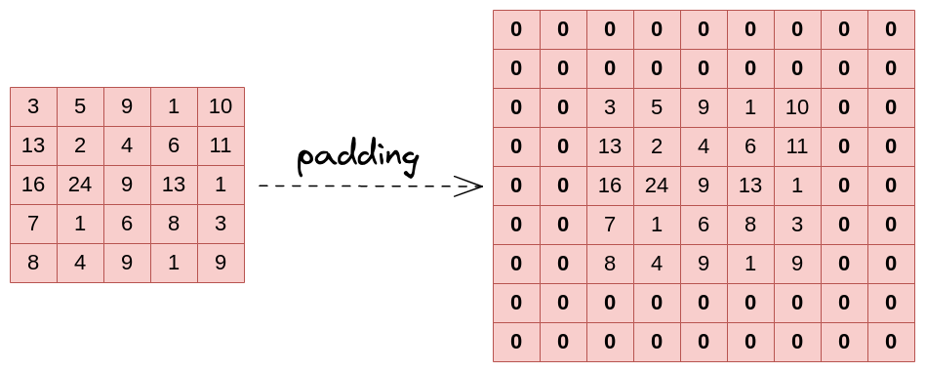
1. Convolution Neural Network
Parameters of Conv2D : padding
- The pixels located on the corners and the edges are used much less than those in the middle => the information on borders and edges are not preserved
Solution?
Add rows and columns of 0 to the input images
The image on left was added with padding parameter P=2
(W, H)
(W + 2P, H + 2P)
Notes:
Take a look at the simple gray scale image below which contains 10 pixels on width & height. The color scale has only 2 values (black & white) or (binary -1 and 1), there fore the size of the following image is 10x10x1:

Slide 22
1. Convolution Neural Network
Parameters of Conv2D : padding
- The pixels located on the corners and the edges are used much less than those in the middle => the information on borders and edges are not preserved
In Keras
padding = “valid”: no padding
padding = “same”: padding with 0 evenly left/right, up/down
padding = “same” with strides = (1,1): output has same size as input
(W, H)
(W + 2P, H + 2P)
Notes:
Take a look at the simple gray scale image below which contains 10 pixels on width & height. The color scale has only 2 values (black & white) or (binary -1 and 1), there fore the size of the following image is 10x10x1:

Slide 23
1. Convolution Neural Network
Parameters of Conv2D :
Depth (L): 3 or 1
Number of Filter: F
kernel: (K, K): (3,3) or (5,5)
Stride (S, S): (1,1) or (2,2)
Padding (P)
Formulation to compute the output size of a convolutional layer from an image with size (W, H)?
W
H

Slide 24
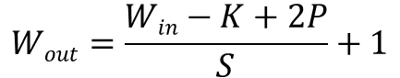
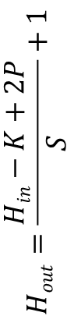
1. Convolution Neural Network
Parameters of Conv2D :
Depth (L): 3 or 1
Number of Filter: F
kernel: (K, K): (3,3) or (5,5)
Stride (S, S): (1,1) or (2,2)
Padding (P)
Formulation to compute the output size of a convolutional layer from an image with size (W, H)?
W_{in}
$$Wout=\frac{Win−K+2P}{S}+1$$
H_{in}
$$Hout=\frac{Hin−K+2P}{S}+1$$
Convoluted features

Slide 25
1. Convolution Neural Network
How to add Conv2D in keras?
model = Sequential()
model.add(Conv2D(F, (K, K), strides=(S, S), activation='relu’, padding=“same”, input_shape=(32, 32, L)))

Slide 26
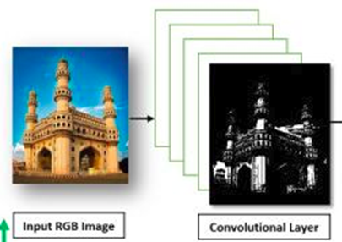
1. Convolution Neural Network
Convolutional Layer (CNN or ConvNet):
(10,10,1)
The CNN will reduce the original RGB images to its Convolutional Layer
Multiple layers can be applied
filters
Notes:
A regular image contains colors RGB with each color scale from 0-255

Slide 27
1. Convolution Neural Network
Pooling Layer
(10,10,1)
Pooling Layer should follow Convolutional Layer
Similar to the Convolutional Layer, the Pooling layer is responsible for reducing the spatial size of the Convolved Feature.
This is to decrease the computational power required to process the data through dimensionality reduction
Two types of Pooling: Max Pooling & Average Pooling.
Notes:
A regular image contains colors RGB with each color scale from 0-255

Slide 28
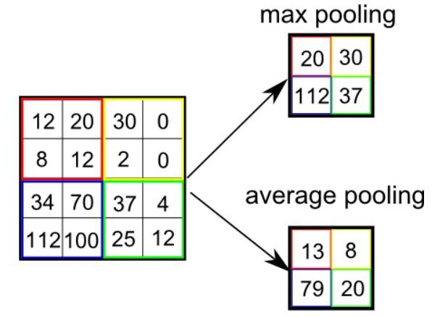
1. Convolution Neural Network
Pooling Layer
(10,10,1)
In which Max Pooling performs a lot better than Average Pooling.
Notes:
A regular image contains colors RGB with each color scale from 0-255

Slide 29
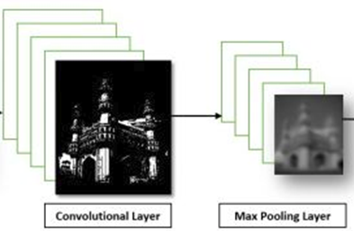
1. Convolution Neural Network
Pooling Layer
The image after Max Pooling layer would look like:
(10,10,1)
Notes:
A regular image contains colors RGB with each color scale from 0-255

Slide 30
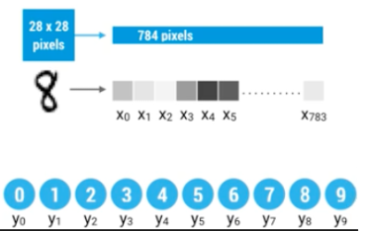
1. Convolution Neural Network
Flatten Layer
Once the images have passed through Convolution Layer and Pooling Layer, its size has been reduced greatly and ready for MLP training (or to another Convolution steps).
The image is then flatten to a column vector and passed through feed-forward NN and BackPropagation applied to every iteration.
Softmax activation function is applied to classified the multi-output/multi-labels
(10,10,1)
Notes:
A regular image contains colors RGB with each color scale from 0-255

Slide 31
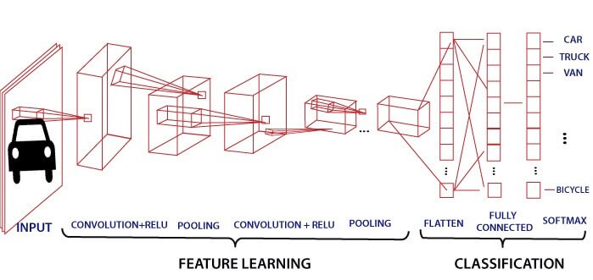
1. Convolution Neural Network
A Sample of CNN:

Slide 32
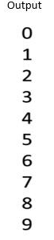
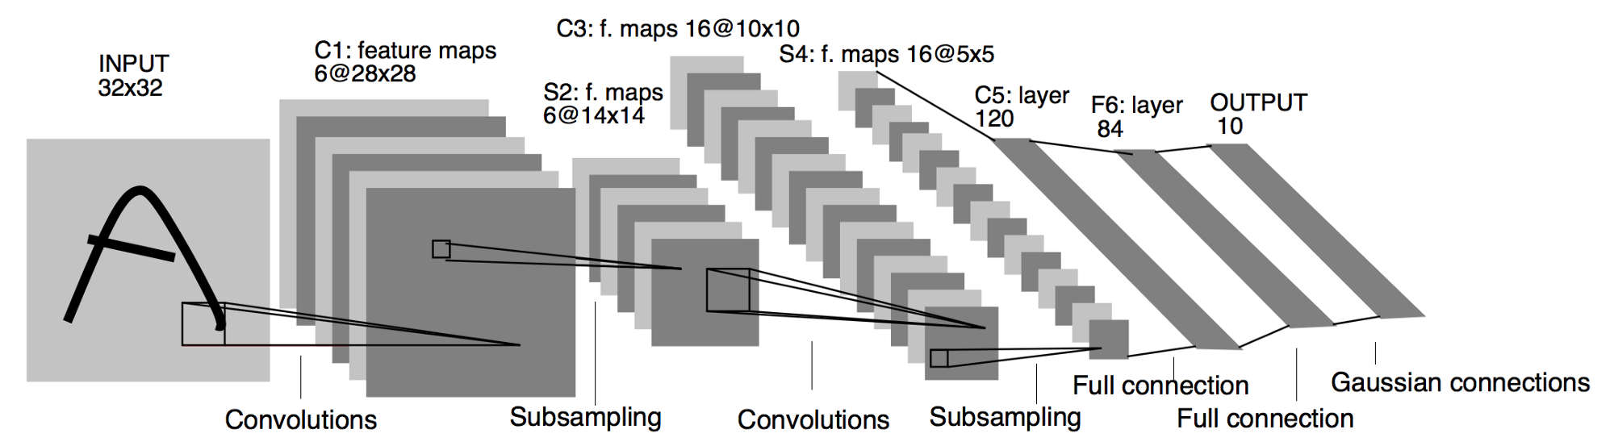
1. Convolution Neural Network
Lenet-5 (1998) by Yann LeCun
LeNet-5 is designed for handwritten and machine-printed character recognition
Input of 32x32x1
Total parameters: 60k
Activation function: tanh

Slide 33
1. Convolution Neural Network
Lenet-5 (1998) by Yann LeCun
model = Sequential()
model.add(Conv2D(6, (5, 5), strides=(1, 1), activation=‘tanh’, padding=“valid”, input_shape=(32, 32, 1)))
model.add(AveragePooling2D(pool_size=(2,2),strides=(2,2)))
model.add(Conv2D(16, (5, 5), strides=(1, 1), activation=‘tanh’, padding=“valid”))
model.add(AveragePooling2D(pool_size=(2,2),strides=(2,2)
model.add(Conv2D(120, (5, 5), strides=(1, 1), activation=‘tanh’, padding=“valid”))
model.add(Flatten())
model.add(Dense(84,activation=‘tanh’))
model.add(Dense(10,activation=‘softmax’))

Slide 34
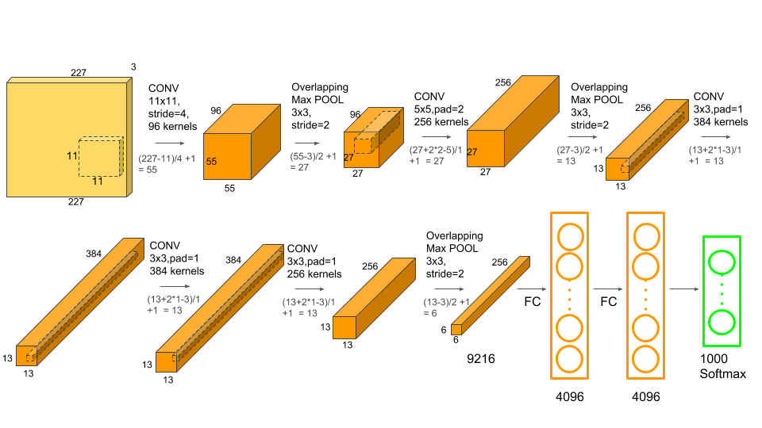
1. Convolution Neural Network
AlexNet (2012) by Hinton Alex Krizhevsky
AlexNet won the 2012 ImageNet challenge
Input of 227x227x3
Total parameters: 60M
Activation: ReLU

Slide 35

1. Convolution Neural Network
AlexNet (2012) by Hinton Alex Krizhevsky

Slide 36
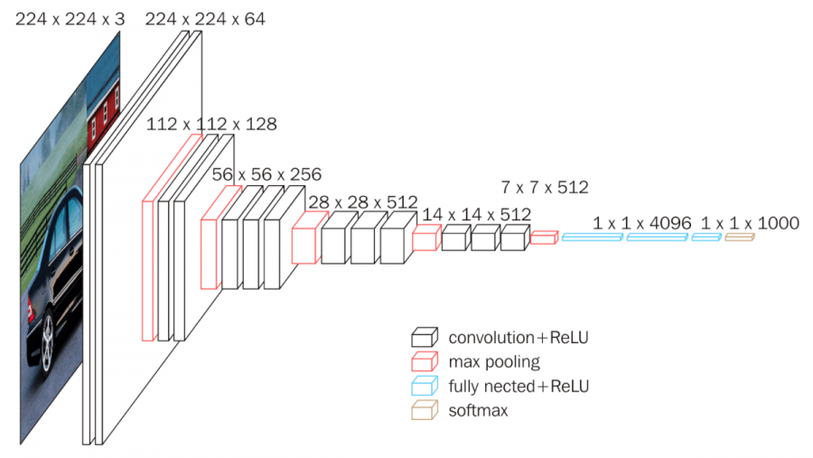
1. Convolution Neural Network
VGG16 (2014) - Visual Geometry Group
VGG16 runner up of 2014 ImageNet challenge
16 layers: 13 ConvNet, 3 Fully Connected
Total Parameters: 130M

Slide 37
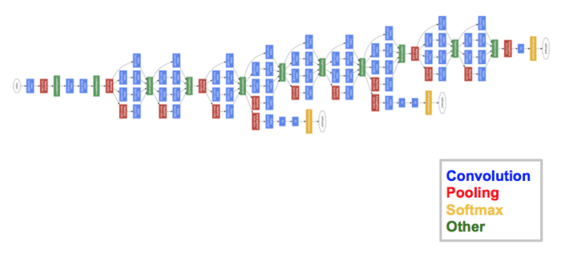
1. Convolution Neural Network
GoogleNet (2014)
GoogleNet won the 2014 ImageNet challenge
Introduced Inception Network
22 layers deep with 27 pooling layers and 9 inception models

Slide 38
2. Recurrent Neural Network

Slide 39
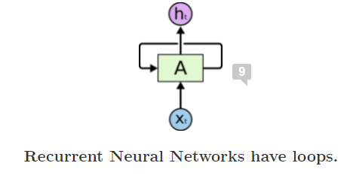
2. Recurrent Neural Network
Introduction
RNNs are type of Deep Learning models with built-in feedback mechanism.
The output of a particular layer can be re-fed as the input in order to predict the output.
This is different from traditional ML where output/predictand cannot be used as input

Slide 40

2. Recurrent Neural Network
Introduction
Unroll the RNN loop

Slide 41
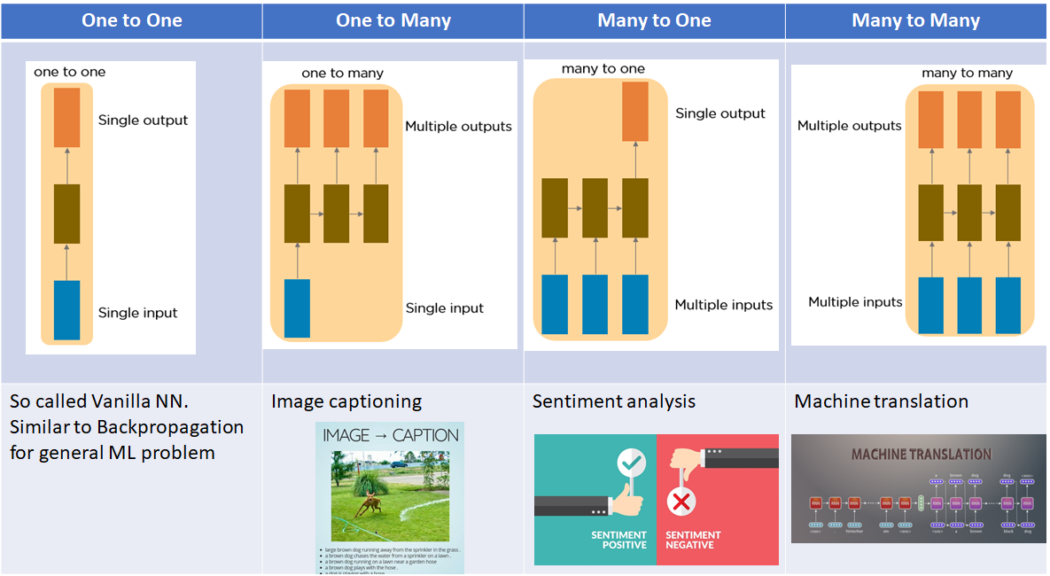
2. Recurrent Neural Network
Type of RNNs

Slide 42
2. Recurrent Neural Network
Applications
It is specifically designed for Sequential problem Weather forecast, Stock forecast, Image captioning, Natural Language Processing, Speech/Voice Recognition

Slide 43
2. Recurrent Neural Network
Some Disadvantages of RNN:
Computationally Expensive and large memory requested
RNN is sensitive to changes in parameters and having gradient problem such as Exploding Gradient or Vanishing Gradient
In order to resolve the gradient problem of RNN, a method Long-Short Term Memory (LSTM) is proposed.
In this limited workshop, we only cover LSTM for timeseries forecast problem (stock forecast and weather forecast)

Slide 44
2. Recurrent Neural Network
Long-Short Term Memory model - LSTM
LSTMs are a special kind of RNN — capable of learning long-term dependencies by remembering information for long periods is the default behavior.
They were introduced by Hochreiter & Schmidhuber (1997) and were refined and popularized by many people
LSTMs are explicitly designed to avoid the long-term dependency problem.

Slide 45
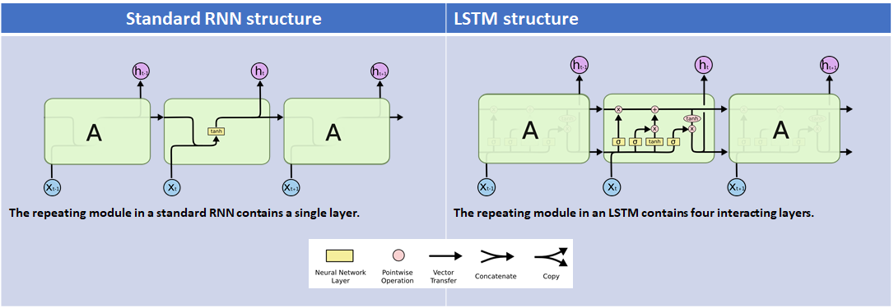
2. Recurrent Neural Network
Comparison between traditional RNN and LSTM

Slide 46
2. Recurrent Neural Network
Comparison between traditional RNN and LSTM
model = Sequential()
model.add(LSTM(128, return_sequences=True, input_shape= (x_train.shape[1], 1)))
model.add(LSTM(64, return_sequences=False))
model.add(Dense(25))
model.add(Dense(1))

Slide 47
2. Recurrent Neural Network
Hands-on section

